Slide 1
Password Management Application
Vignesh Pillutla – RollNo.:27
Manas Raut – RollNo.:36
Yash Sawant – RollNo.:40
Mihir Singh– RollNo.:49
Group No.: 2
Date of presentation: 14/12/2020
Under the guidance of: Prof. Anushree Patkar.
Atharva College of Engineering
Department of Information Technology

Slide 2
Content
1. Introduction
1.1 Introduction
1.2 Motivation
1.3 Problem Statement
1.4 Objectives
2. Literature Survey
2.1 Survey of Existing system
2.2 Limitation Existing system or research gap
2.3 Mini Project contribution
3. Proposed System
3.1 Architecture/Framework
3.2 Algorithm and Process Design
3.3 Software Requirement Specification
3.5 Output Screenshots
4. Conclusion
5. Future work
References
ACE- IT department Project Title

Slide 3
Introduction
Motivation
In this era of internet more and more people are coming online. Thus protecting users data is important and mainly passwords are used to authenticate their accounts. People tend to forget passwords so they make similar passwords for all accounts thus increasing danger. So application is needed to store this password securely.
ACE- IT department Project Title

Slide 4
Problem Statement
The current scenario on internet is to login on different websites to with different usernames with different passwords which may be forgotten. To avoid this people set similar passwords for most of their accounts which compromises their security.
The password management application saves the passwords on one single application and uses encryption to secure them. Users can access all saved passwords by just login into only one application.
ACE- IT department Project Title

Slide 5
Objectives
To store passwords in a single application to make them easily accessible.
To secure them by applying encryption.
To make application UI as simple as possible.
ACE- IT department Project Title

Slide 6
Literature Survey
Survey of existing system:
In the Era of Online World, people regularly login on different websites. They tend to forgot their passwords, which in result have to waste time on trying to login, calling for help desk, proving their identity,etc. Each problem incident may consume 20-30 minutes of user. This can create great havoc for users who are just to login for their simple tasks.
6
ACE IT department Project Title

Slide 7
2.2 Limitation of Existing system or Research gap:
Many people use similar passwords on most of their websites so they do not forget them. But this makes them insecure as a person only needs to know one password in order to get access of all the accounts. People also write down their passwords in certain applications where they are very vulnerable
ACE- IT department Project Title

Slide 8
2.3 Mini project contribution:
The application has contribution of saving user’s time by storing websites usernames and passwords in a single application while passwords are in encrypted form and can be only accessed by particular user through application’s username and password. Application also provides double layer of security by using privacy pin as means to view or edit stored passwords.
ACE- IT department Project Title

Slide 9
Proposed System
Architecture/Framework:
All windows are independent of each other.
They use common classes like Encryption and database classes.
Application uses RSA encryption algorithm which is a asymmetric encryption algorithm which uses two keys public key and private key.
Public key used to encrypt data and is available for others.
Private key is used to decrypt data which should be kept private.
SQLite is used for database.
ACE - IT department Project Title

Slide 10
Algorithm and Process Design
LogIn
SignUp
Home
NewPassword
CompleteView
ChangeProperty
ActionCnfm
ACE- IT department Project Title

Slide 11
Proposed system
Software Requirement Specification
Java JDK 8 or higher
SQLite JDBC driver
IDE (eg. Intellij, Eclipse)
Windows OS
Output Screenshots:
ACE- IT department Project Title

Slide 12
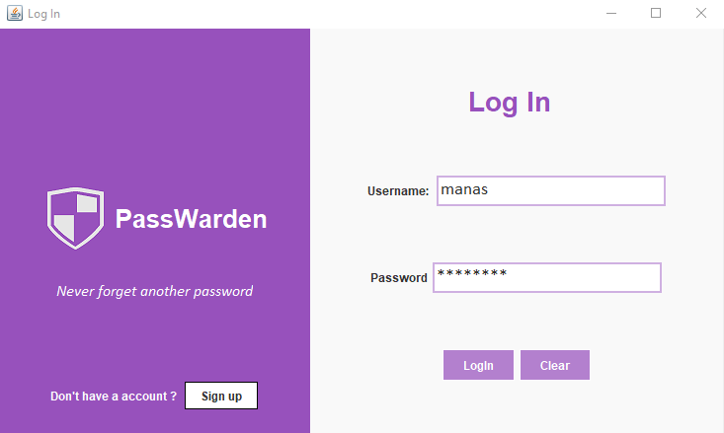
ACE- IT department Project Title

Slide 13
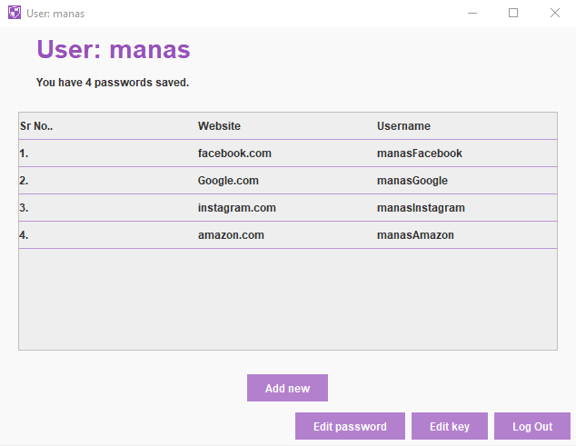
ACE- IT department Project Title

Slide 14
Conclusion
Thus we conclude that the application helps people to secure their passwords indirectly securing their data.
Its UI makes it as easy as possible to use the application
ACE- IT department Project Title

Slide 15
Future Work
We plan to make the application available on the internet making it accessible on any device which has internet connection.
Further more than just passwords like sensitive data and notes can also be secured using the password management application.
ACE- IT department Project Title

Slide 16
References
1. RSA algorithm :- Wikipedia.com
2. Java the complete reference :- by Herbert Schildt
ACE- IT department Project Title

Slide 17
Questions??
Thank You!
ACE- IT department Project Title

